Slide 1

IMPACT OF CLIMATE ON COCONUT YEILD IN THE COCONUT TRIANGLE
Miss J A S Perera
2015/SP/108
Department of Mathematics & Statistic
University of Jaffna

Slide 2


Outline
Background & Introduction of the study
Literature Review
Objectives
Methodology
References

Slide 3

Background & Introduction of the Study
Coconut is most important to Sri Lanka.
Coconut is important tree crop among the humid tropical regions.
Coconut is perennial crop.
Sri Lanka is 4th rank of world coconut production and land extent.
ANCP is with mean 2427 millions nuts.
Coconut contributed 1.3% of GNP in 2002
Provides 22% calories & 2nd only the rice.
Fresh nuts export and manufacture many products.
Coconut production fluctuated mainly due to the major climatic parameters.
Effect of current climate change is usually reflected on NCP.
The degrees of influence of these variables on coconut yield is unknown in the coconut triangle.
An attempt is made to study impact of climate on the coconut yield in coconut triangle and determine their relationships

Slide 4

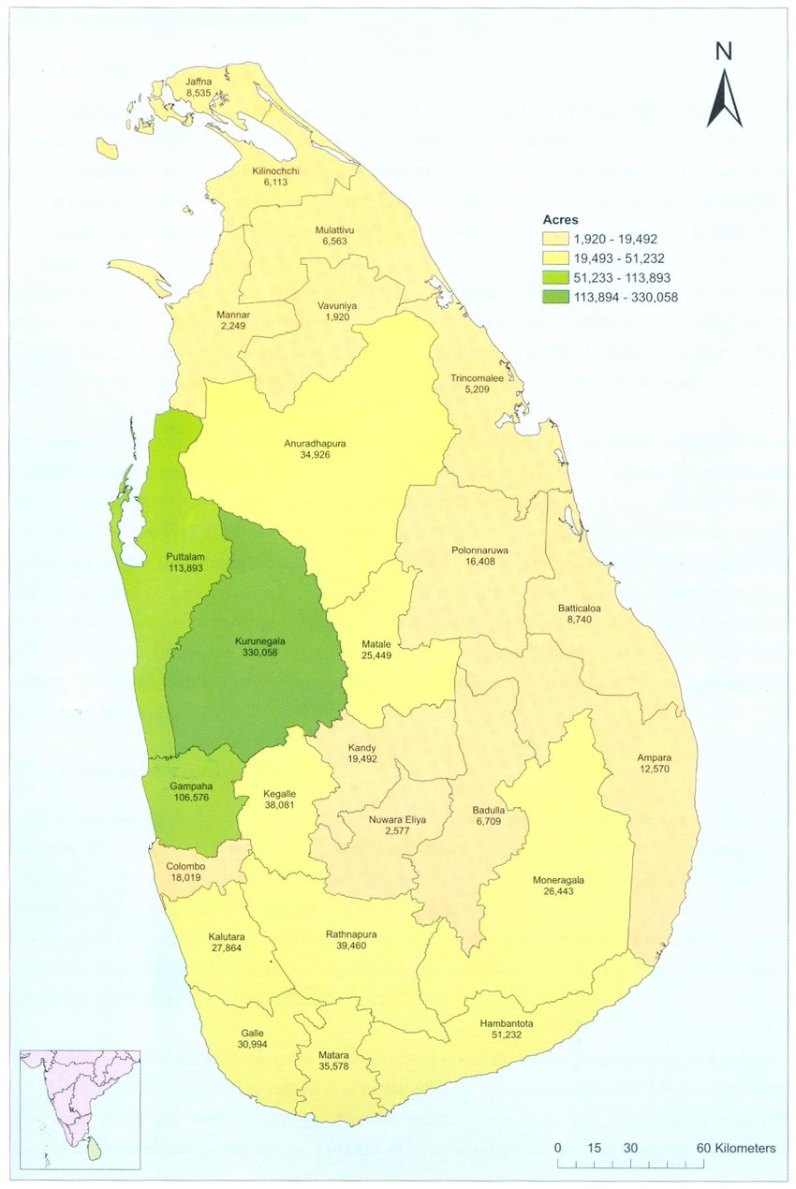
Coconut Triangle
Puttalam District
Kurunagala District
Gampaha District

Slide 5
2013
2013
2014
2015
2016

Slide 6
2013
2014

Slide 7

Major climatic variables
Major climatic elements are Rainfall , Temperature and Relative Humidity.

Slide 8
2018
2013
2014
2015
2016
2017
2013

Slide 9
2013
2014
2015
2016
2017
2018
2013
2014
2015
2016
2017
2018

Slide 10
2013
2014
2015
2016
2017
2018
2013
2014
2015
2016
2017
2018

Slide 11
2013
2013
2014
2015
2016
2017
2018

Slide 12

Literature Reviews
T.S.G Peiries and R.R.A Peiries(CRI) (1993) conducted study on effect of bimonthly rainfall on coconut yield in the low country intermediate zone of Sri Lanka based on data two-monthly sub periods at Ratmalgara state .
Multiple regression model
R²=0.89
Explanatory variables are cumulative rain fall
T.S.G Peiris and R.O.Thattil(1997) conducted the Assessment of the effect of environmental factors on yield of coconut .
Multiple regression model
R²=0.75
Explanatory variables are 8 climatic variables
Auguste Emmanuel and Sylvain N’cho (2018) conducted Shifted effects of 3 years of the minimum temperature, rainfall and water deficit on the nuts yielding expression in Cocos nucifera L.,Cote d’lvoire.
Multiple regression model
R²=0.617
Explanatory variables are 6 climatic variables

Slide 13

Objectives
Study the impact of climate on coconut yield in coconut triangle
Develop the statistical model

Slide 14
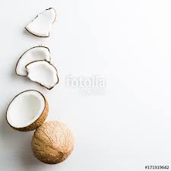
Research Methodology
Study area: Coconut Triangle
Data :
Independent variables(monthly rainfall(x₁), temperature(x₂) and relative humidity(x₃))
From the Metrological Department and Census and Statistic website
Dependent variable(coconut production(y))
From CRI

Slide 15
Methodology
Regression model
Model selection
(Stepwise Regression )
Data collection
Final Model
Y=β₀+β₁X₁+β₂X₂+……+β_{k}X_{k}+ϵ
Y:dependent variable
X_{i} :independent variables
Β₀:constant
Β s: coefficients
ϵ:error term(ϵ~N(0,б²))
Check the assumptions

Slide 16

References
Census and Statistic
http://www.statistics.gov.lk/
Metrological department
http://www.meteorogydepartment.gov.lk
Effect of bimonthly rainfall on coconut in the low country intermediate zone(IL₁) of Sri Lanka(T.S.G.Peiris & R.R.A.Peiris)(CRI)
Assessment of factors affecting coconut production in Tanzaniya(Muyengi Z.E. ,Msuya E. ,Lazaro E.)
(http://academeresearchjournals.org/journal/jaed)
Shifted effect of three years of minimum temperature, rainfall, and water deficit on the nut yielding expression in Cocos nucifera L.,Cote d’lovire(August Emmanuel Issali , Syllavain N’cho,Abdourahamane Sangare)(Biodiversity International Journal)
Assessment of the effect of environmental factors on yield of coconut(cocos nucifera,L1) (T.S.G.Peiris & R.O.Thattil)(CRI,University of Peradeniya)
Annual Report 2017 ,Coconut Research Board,Ministry of plantation Industries
Climate change and coconut plantation in India:impacts and potential adaptation gains(S.Naresh Kumar & P.K.Aggrawal)(Central plantation crops Research institute,Kerala,India)
www.elsevier.com/locate/agsy

Slide 17

THANK YOU

